Slide 1
Network Intrusion Detection
CAPSTONE PROJECT
Presented By:
Student Name : Dhanush J
College Name : Perunthalaivar Kamarajar Institution of Engineering and Technology
Department : Information Technology

Slide 2
OUTLINE
Problem Statement (Should not include solution)
Proposed System/Solution
System Development Approach (Technology Used)
Algorithm & Deployment
Result (Output Image)
Conclusion
Future Scope
References

Slide 3
Problem Statement
With the rapid expansion of digital infrastructure and internet usage, modern networks are increasingly exposed to a wide range of cyber threats. In many organizations and service providers, identifying unauthorized access or malicious activity in real time has become a growing concern. These threats not only compromise sensitive data but can also lead to significant operational disruptions and financial loss. Therefore, detecting abnormal patterns in network traffic is critical to maintaining system integrity and ensuring secure communication across digital platforms.

Slide 4
Proposed Solution
The proposed system aims to build a machine learning-based Network Intrusion Detection System (NIDS) that can accurately identify and classify different types of network attacks. The approach includes the following steps:
Data Collection:
Use a publicly available dataset that contains labeled network traffic data, including both normal activity and various attack types such as DoS, Probe, R2L, and U2R. This dataset provides essential features like protocol type, service, connection duration, and traffic behavior.
Data Preprocessing:
Handle missing or inconsistent data, convert categorical features (e.g., protocol, service, flag) using encoding techniques, and scale numerical features using normalization. This ensures uniformity and better performance of the model.
Model Development:
Train a classification model such as Random Forest, which can handle high-dimensional data and provide reliable predictions. The model learns patterns from historical traffic to distinguish between normal and attack behavior.
Deployment:
The trained model is deployed to IBM Cloud using Watson Machine Learning services. It can then be accessed through a REST API, allowing real-time or batch predictions from external applications.
Evaluation:
Assess the model using metrics such as accuracy, precision, recall, F1-score, and confusion matrix. Fine-tune the model as needed and monitor performance regularly to adapt to evolving threats.
Result: Github Link : https://github.com/dhnaush0745/Network-Intrusion-Detection-ML.git

Slide 5
System Approach
The proposed system builds a machine learning-based Network Intrusion Detection System (NIDS) to classify network traffic as normal or malicious.
System Requirements:
A system with internet access (8 GB RAM recommended).
Python 3.8+ with Jupyter Notebook or Google Colab for development.
IBM Watson Studio and IBM Cloud Object Storage for model deployment.
Required Libraries:
pandas and numpy for data manipulation.
scikit-learn for preprocessing, training, and evaluation.
matplotlib and seaborn for visualizations.
joblib` to save the model, scaler, and encoder.
requests and json to interact with the IBM Cloud API.
This approach ensures a scalable, cloud-deployed solution with real-time prediction capability.

Slide 6
Algorithm & Deployment
Algorithm Selection:
A Random Forest Classifier was chosen for its robustness, high accuracy, and ability to handle mixed data types. It is well-suited for classifying complex patterns in network traffic.
Data Input:
The model uses features like `duration`, `protocol_type`, `src_bytes`, `dst_bytes`, and other network traffic attributes. All categorical fields are label-encoded, and features are normalized for better performance.
Training Process:
The model is trained on labeled historical data with known attack types. Techniques such as label encoding, scaling, and feature engineering were applied. Cross-validation was used to avoid overfitting.
Prediction Process:
Once trained, the model predicts whether new network data points are normal or a specific type of attack. Predictions are made in real-time and can be consumed through an API endpoint.
Deployment:
The model is deployed on IBM Watson Machine Learning using a REST API. It can be accessed via a secured token for scalable and cloud-based inference.

Slide 7
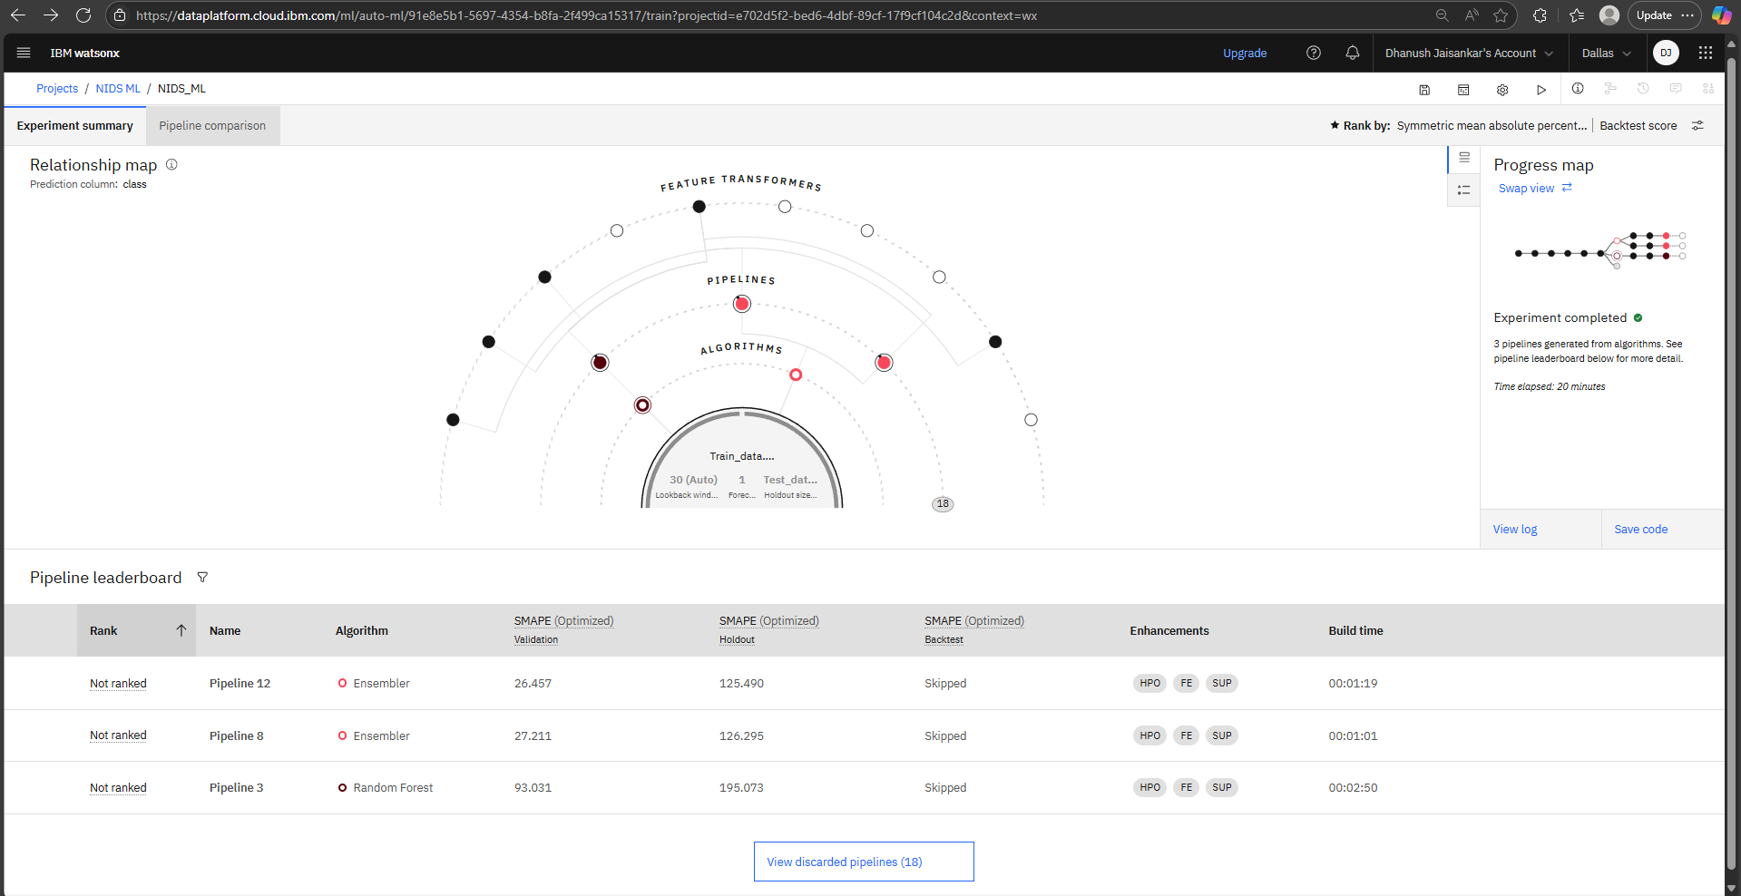
Result
Accuracy : ~ 93.03 %

Slide 8
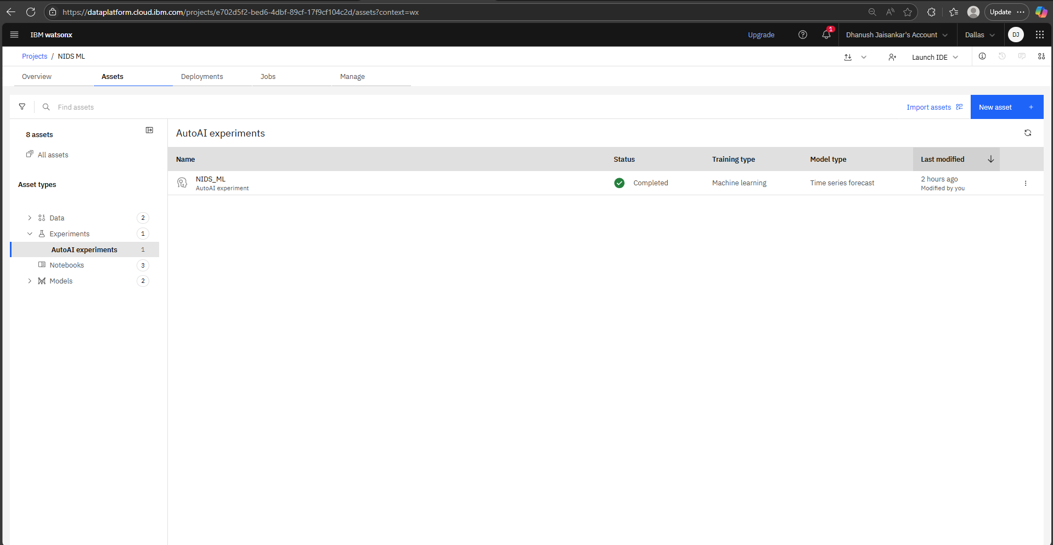
Result
Accuracy : ~ 93.03 %

Slide 9
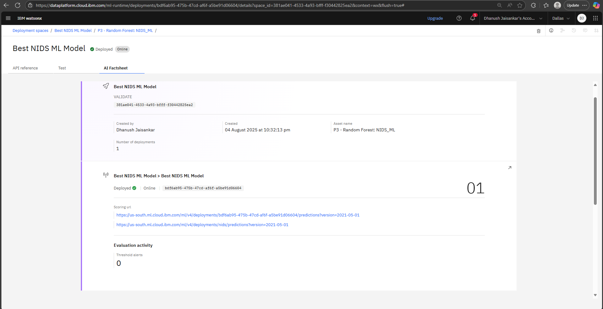
Result
Accuracy : ~ 93.03 %

Slide 10
Conclusion
The developed Network Intrusion Detection System effectively identifies and classifies malicious network traffic using machine learning. The Random Forest model demonstrated high accuracy in detecting various types of attacks, making it suitable for real-world deployment.
Throughout the project, key challenges included preprocessing categorical network features and ensuring compatibility with IBM Cloud services. These were addressed through proper encoding, scaling, and deployment steps.
The solution showcases the power of ML in enhancing cybersecurity and offers early warnings against potential intrusions. Future improvements could involve using deep learning or unsupervised techniques to detect unknown threats and adapting the system for live traffic monitoring.

Slide 11
Future scope
Additional Data Sources:
Integrate real-time network logs, firewall alerts, and threat intelligence feeds to improve detection accuracy.
Algorithm Optimization:
Experiment with deep learning models like LSTM or autoencoders for detecting sophisticated or unknown attack patterns.
Scalability:
Extend the system to monitor traffic across multiple networks, organizations, or regions.
Edge Computing Integration:
Deploy lightweight versions of the model at network edges to enable faster, localized intrusion detection.
Automation & Alerts:
Integrate with automated security systems for real-time alerts and incident response.

Slide 12
References
Aggarwal, C. C. (2015). Data Mining: The Textbook. Springer.
Provided foundational understanding of ML algorithms and evaluation metrics.
Dua, D., & Graff, C. (2019). UCI Machine Learning Repository: KDD Cup 1999 Data.
→ Used as a benchmark dataset for training the intrusion detection model.
[https://kdd.ics.uci.edu/databases/kddcup99/kddcup99.html](https://kdd.ics.uci.edu/databases/kddcup99/kddcup99.html)
Breiman, L. (2001). Random Forests. Machine Learning, 45(1), 5–32.
→ Core algorithm used for classification in the project.
IBM Cloud Docs. Watson Machine Learning.
→ Guided deployment and model serving on IBM Cloud.
[https://cloud.ibm.com/docs/watson-machine-learning](https://cloud.ibm.com/docs/watson-machine-learning)
Scikit-learn Documentation. Machine Learning in Python.
[https://scikit-learn.org/stable/user\_guide.html](https://scikit-learn.org/stable/user_guide.html)
→ Used for preprocessing, training, and evaluation.

Slide 13

IBM Certifications

Slide 14

IBM Certifications

Slide 15

IBM Certifications

Slide 16
THANK YOU

